Slide 1
The Beginning of the End
The second front
D-Day: Normandy Landings
The final collapse

Slide 2
Class brainstorm
What have we learnt so far?

Slide 3
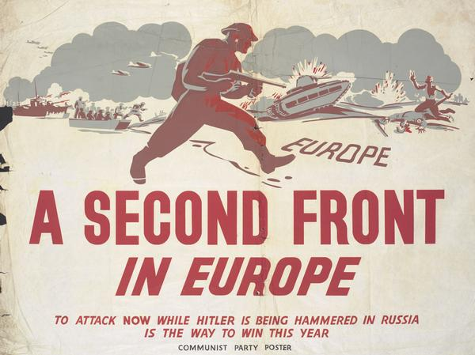
The Second Front
The second phase consisted of large-scale ground combat (supported by a massive air war considered to be an additional front), which began in June 1944 with the Allied landings in Normandy and continued until the defeat of Germany in May 1945.

Slide 4
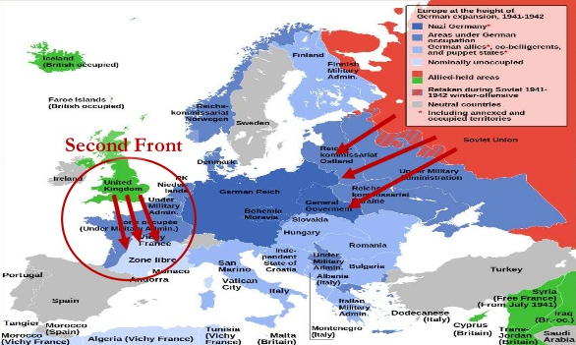

Slide 5
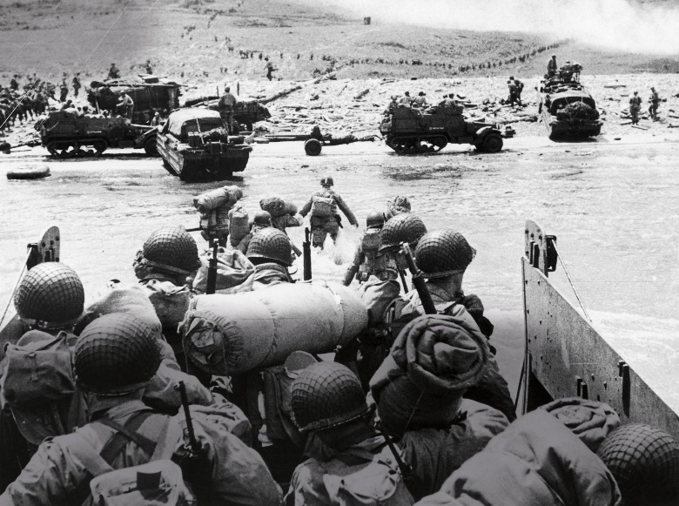
D-Day: Normandy Landings
During World War II (1939-1945), the Battle of Normandy, which lasted from June 1944 to August 1944, resulted in the Allied liberation of Western Europe from Nazi Germany’s control. Codenamed Operation Overlord, the battle began on June 6, 1944, also known as D-Day, when some 156,000 American, British and Canadian forces landed on five beaches along a 50-mile stretch of the heavily fortified coast of France’s Normandy region. The invasion was one of the largest amphibious military assaults in history and required extensive planning. Prior to D-Day, the Allies conducted a large-scale deception campaign designed to mislead the Germans about the intended invasion target. By late August 1944, all of northern France had been liberated, and by the following spring the Allies had defeated the Germans. The Normandy landings have been called the beginning of the end of war in Europe.
https://www.history.com/topics/world-war-ii/d-day#&gid=ci0241980a10002494&pid=d-day_gettyimages-600204788

Slide 6
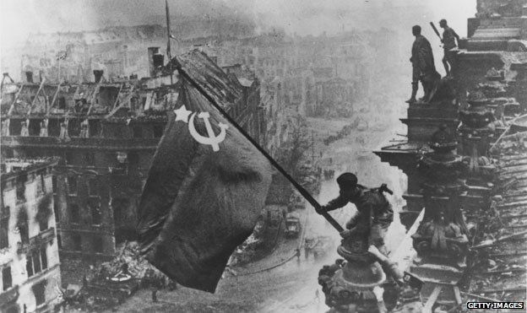
The final collapse
By July 1944 Allied armies were pushing back Germans in the west and east.
In early 1945 some of the most extreme air raids began.
In two nights of bombing up to 150,000 people were killed in Dresden.
By the end of the war almost as many German civilians had died as German soldiers.
By early 1945 government plans were in chaos.
Food rationing was unorganised, as defeat loomed, stars of David could be purchased on the Black Market.
In April 1945 as Russian troops were taking over Berlin, Hitler, Goebbels and other Nazi officials committed suicide.
With the war lost, many Germans tried to prove they had opposed the Nazi regime all along.
https://www.youtube.com/watch?v=mJBLlBvI3bw

Slide 7
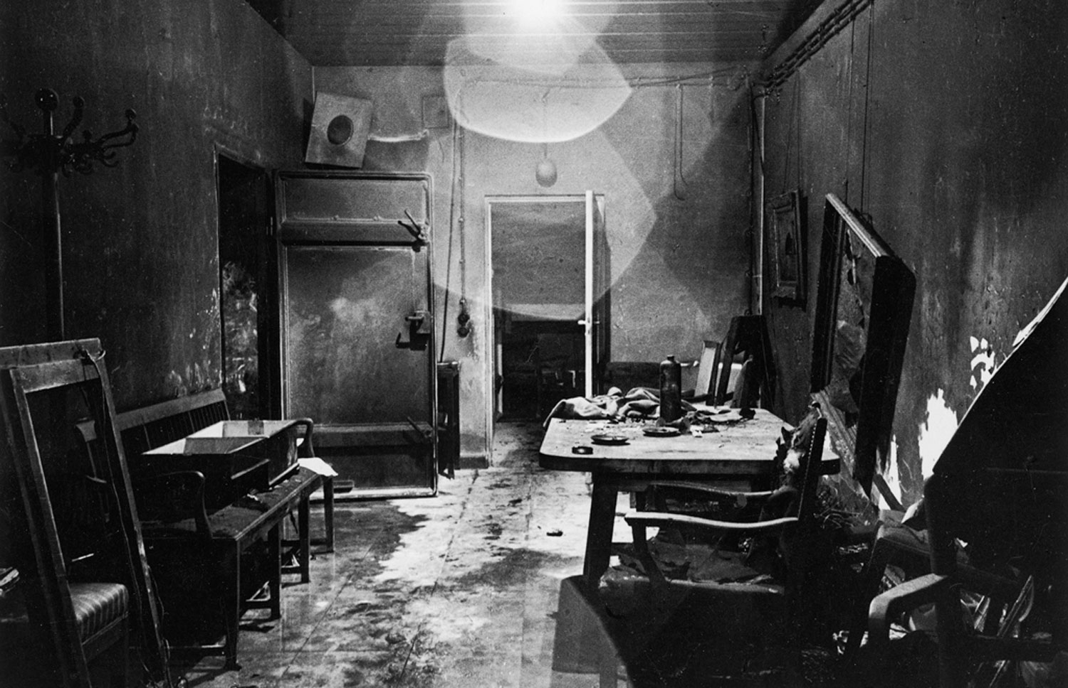
Hitler’s bunker

Slide 8
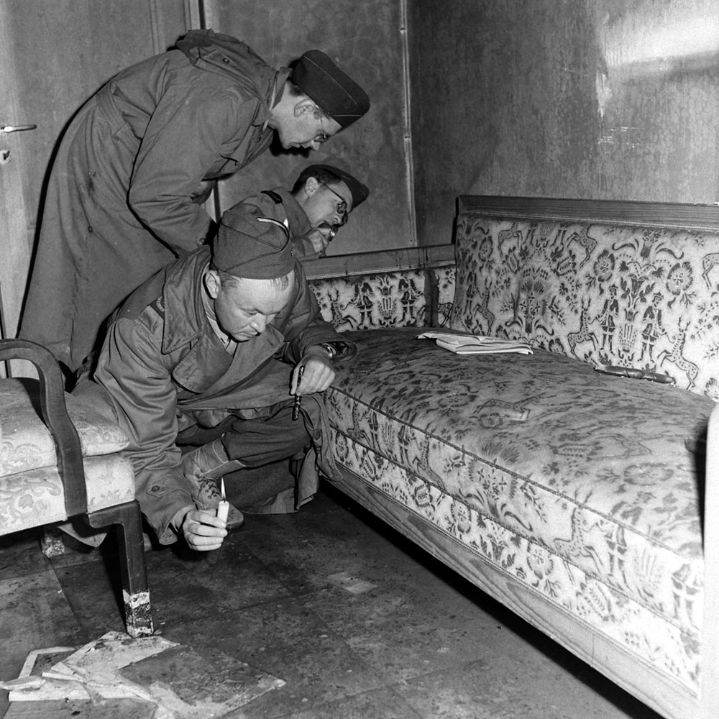
With only candles to light their way, war correspondents examine a couch stained with blood (see dark patch on the arm of the sofa) located inside Hitler's bunker.

Slide 9
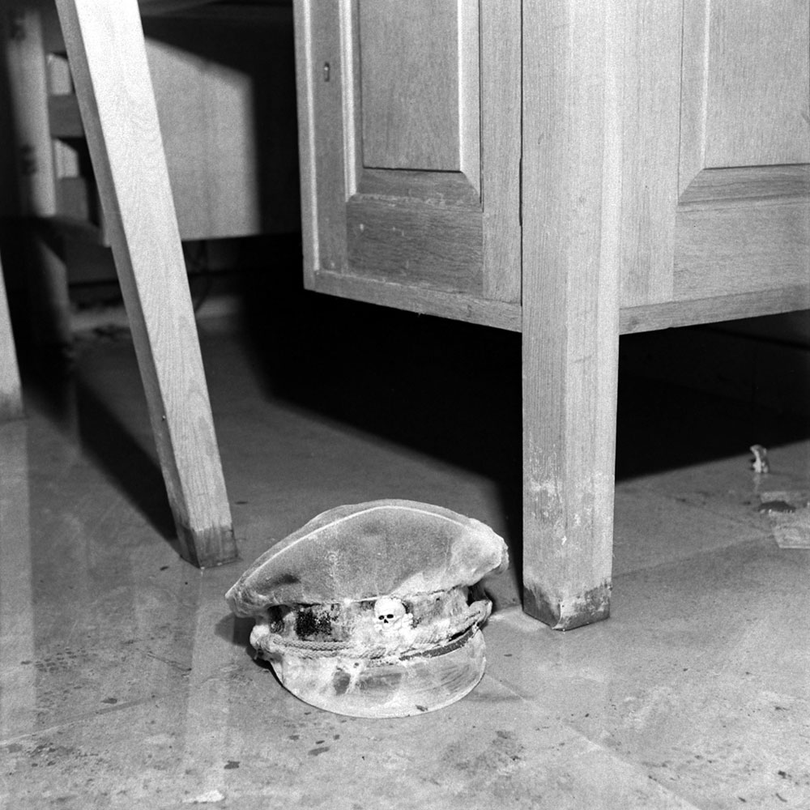
An SS officer's cap, with the infamous death's-head skull emblem barely visible.

Slide 10
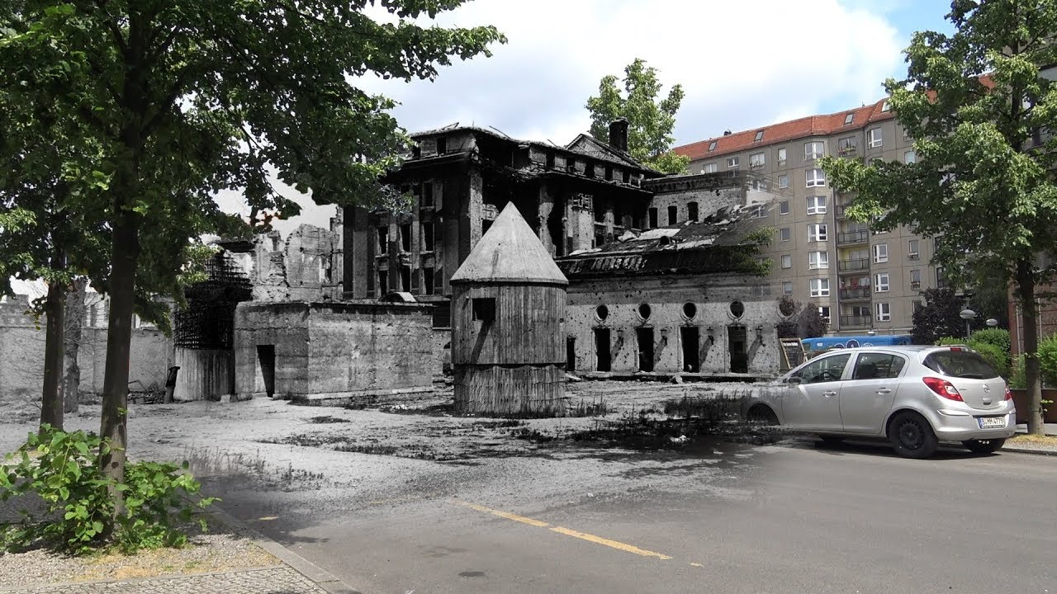
Hitler’s bunker now

Slide 11
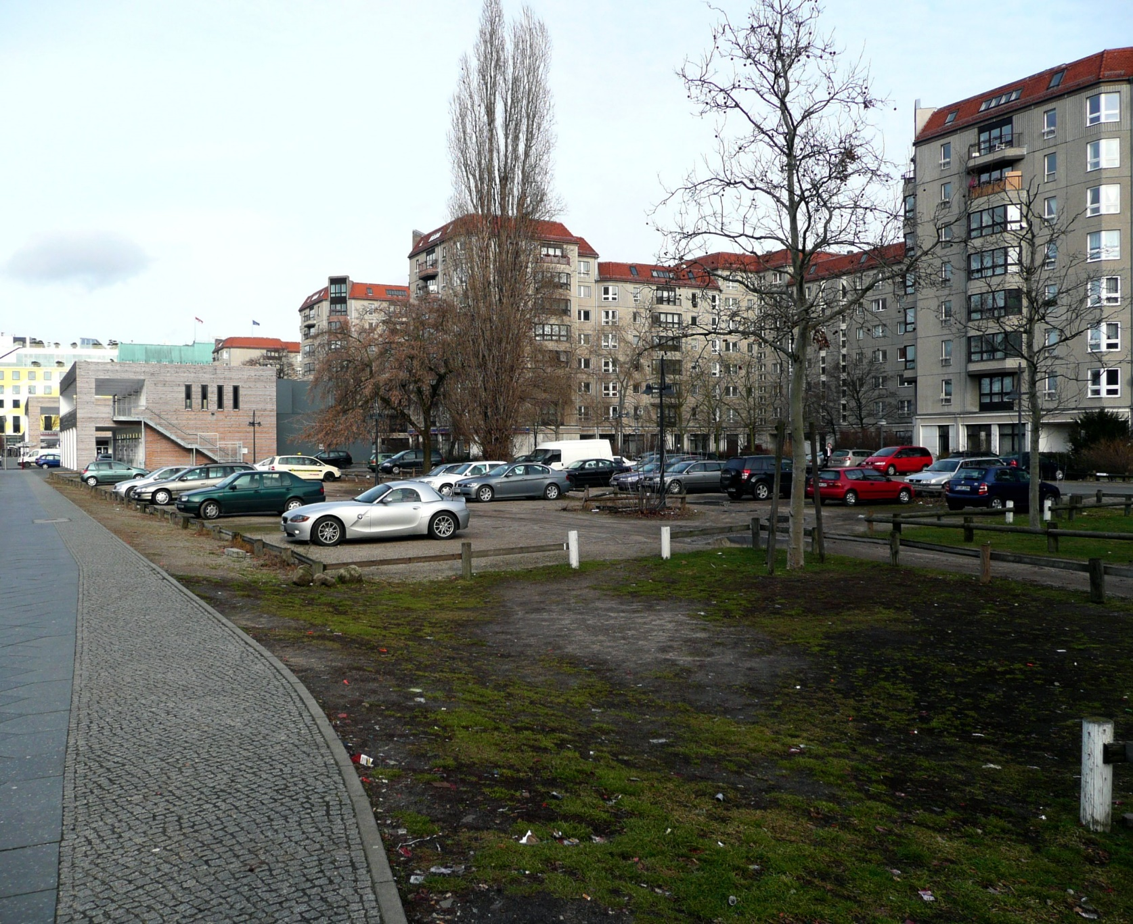
Hitler’s bunker now

Slide 12
Source analysis assessment
1. In what ways were the Jews in Germany persecuted from 1935-1939? What specific events precipitated the Holocaust?
2. What is appeasement and why did the allies pursue a policy of appeasement in the lead up to ww2?
Revision:
Persecution of Jews
Nazi foreign policy 1936-39
Hitler’s 5 main foreign policy aims (Treaty of Versailles; Removal of Germany from the League of Nations; Lebensraum; Greater German Reich/uniting all German speaking people; Territory – East (Russia), Czechoslovakia, Poland)
Appeasement

